Slide 1
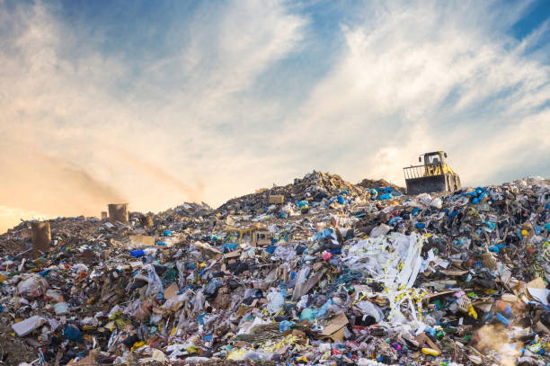
Waste Image Classification with CNN and TRANSFER LEARNING
Siddhant Iyer
Imarticus Learning – PGA 33

Slide 2
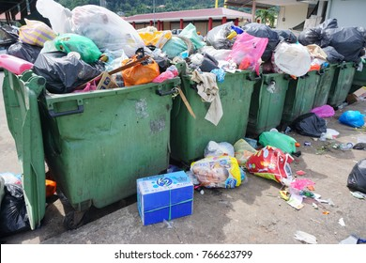
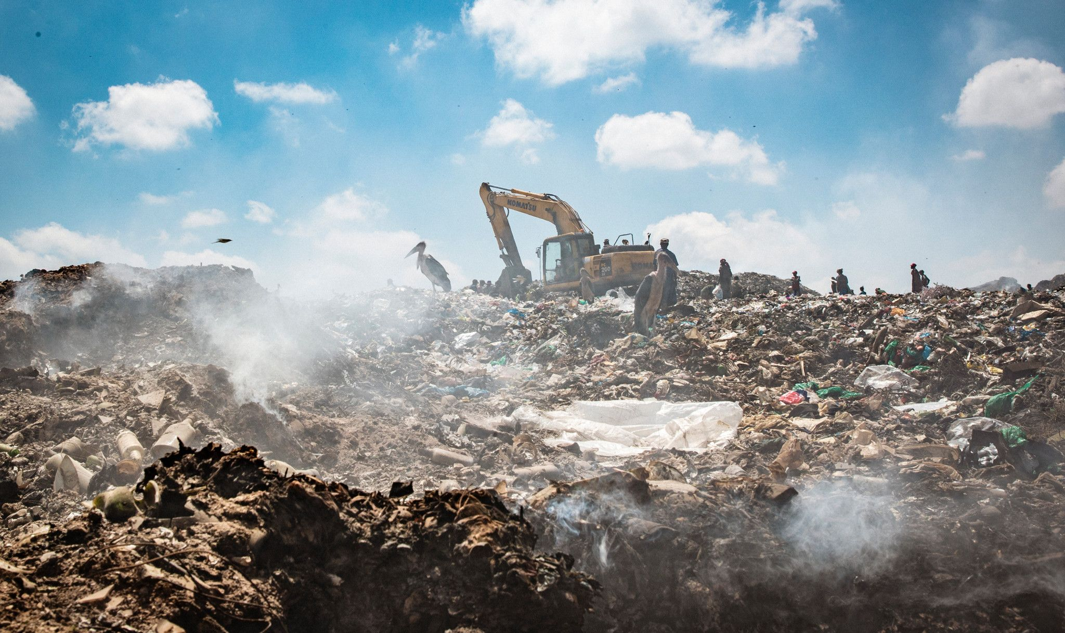
Problem Statement
Improper waste segregation leads to poor waste management resulting in: inefficient recycling, increased pollution, eutrophication, contamination of recyclable materials, consumption of toxic waste by animals
Manual waste sorting → incredibly error prone, confusing and time consuming
Important to be able to effectively segregate wastes into the appropriate categories so that they can be treated accordingly

Slide 3
Objective
Build a highly optimized Deep Learning model to classify waste images into two categories: Organic (O) and Recyclable (R)
Evaluate and compare performance of three models: Convolutional Neural Network (CNN), Transfer Learning model (MobileNetV2) and an ensemble model (CNN + MobileNetV2)
Deploy the best performing model by developing an interactive, user-friendly web-based waste classifier using Gradio

Slide 4
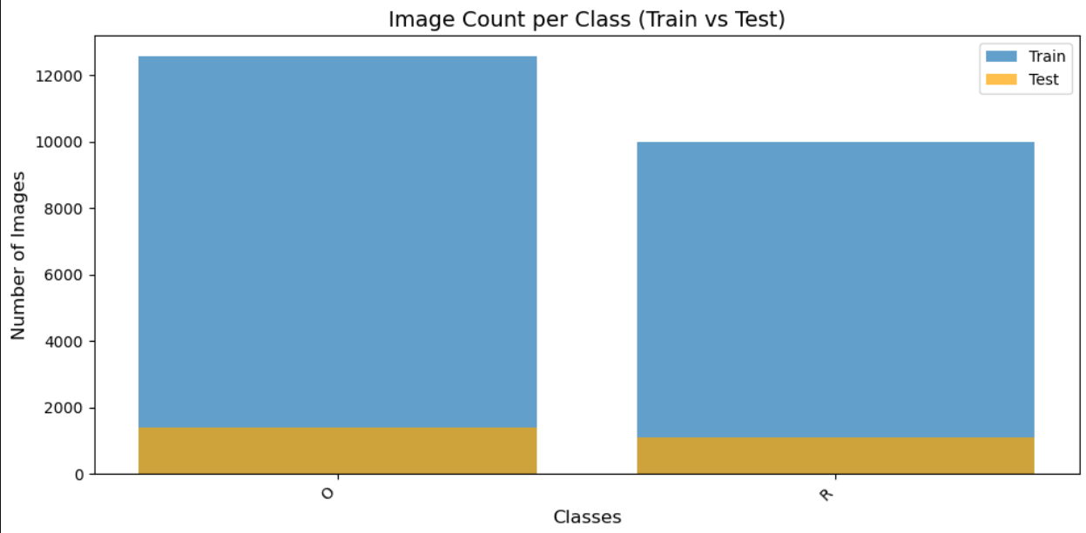
About the data
Waste Images dataset was downloaded from Kaggle: https://www.kaggle.com/datasets/techsash/waste-classification-data
Divided into Train and Test folders
Each folder contains two sub-folders: Organic (O) and Recyclable (R)
Train folder has: 12565 images (O), 9999 images (R)
Test folder has: 1401 images (O), 1112 images (R)

Slide 5
Pre-processing
Remove corrupted or unreadable images using cv.imread() from OpenCV library.
Resize the image to 224 x 224 pixels to maintain a consistent input size for CNN and MobileNetV2
Normalization: scaled the pixel values from range [0,255] to [0,1] using rescale = 1./255 in ImageDataGenerator
Data augmentation techniques performed: Rotation, width and height shifting, shearing, zooming, horizontal flipping
Split the Training dataset into train (80%) and validation (20%)
Notes:
cv.imread() tries to read each image, if the image is unreadable, it returns None or throws an error and deletes the image

Slide 6
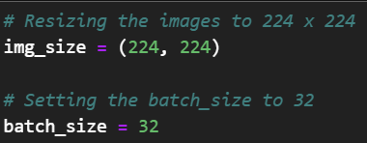
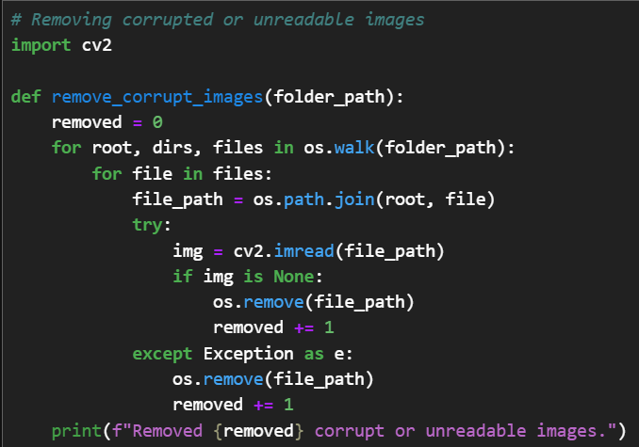
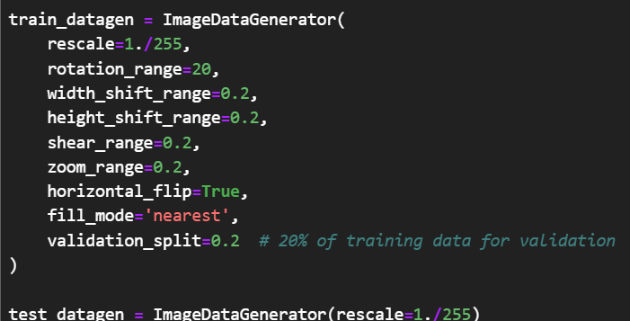
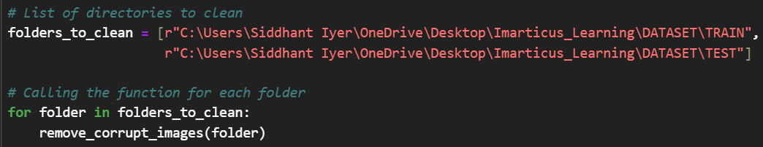
Image Pre-processing and Data augmentation
Removing corrupted or unreadable images

Slide 7
Building the Base CNN Model
Input
Input image size: 224 × 224 × 3
Model Architecture
3 Convolutional layers with ReLU activation, Max Pooling after each convolution, Flatten layer to convert 2D features to 1D, Dense layer with 512 neurons and ReLU, Output layer with Softmax activation for 2 classes
Training Configuration
Adam optimizer with 0.001 learning rate, Categorical Crossentropy loss function, Early Stopping to prevent model overfitting
Epochs = 30
Model Performance
Training time: 12.8 hours
Validation Accuracy: 0.8785
Validation Loss: 0.3075

Slide 8
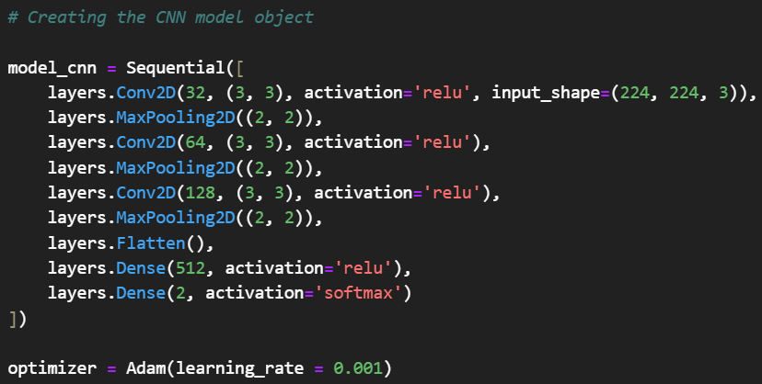
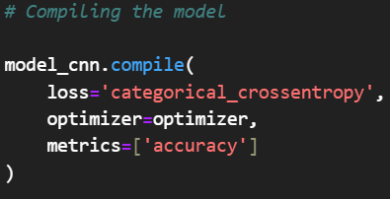
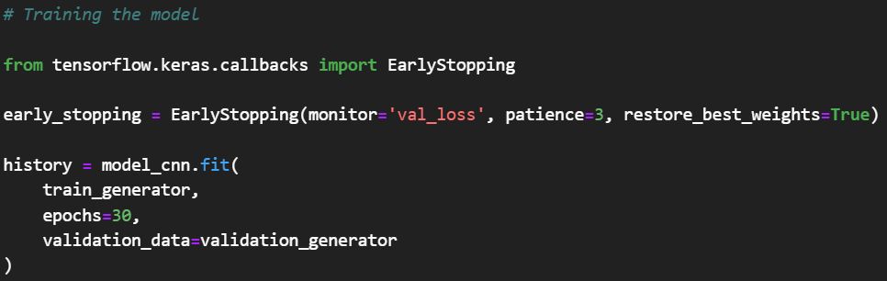

Slide 9
Why choose MobileNetV2?
Pre-trained model (more than 1.4 million images)
Understands general features like edges, textures, shapes
Only need to fine tune on the waste image dataset (Transfer Learning) and it can reuse its learnt knowledge.
Simpler architecture allows effective feature extraction with fewer parameters
Specifically designed to work well on devices with limited computing power (such as mobile phones)
Notes:
MobileNetV2 works well on mobile devices, which is what we want when we deploy the model. It needs to be simpler and effective to use.

Slide 10
Building the MobileNetV2 model
Input
Input image shape: 224 × 224 × 3
Model Architecture
Import a base pre-trained MobileNetV2 model from tensorflow.keras.applications
Adding custom layers such as Global Average Pooling, Dense layer with 512 neurons and ReLu activation, Dropout rate of 0.5, Output layer with Softmax activation for 2 classes
Training configurations
Adam optimizer with 0.001 learning rate, Categorical Crossentropy loss function
Epochs = 10
Model Performance
Training time: 1.45 hours
Validation Accuracy: 0.9453
Validation Loss: 0.1553

Slide 11
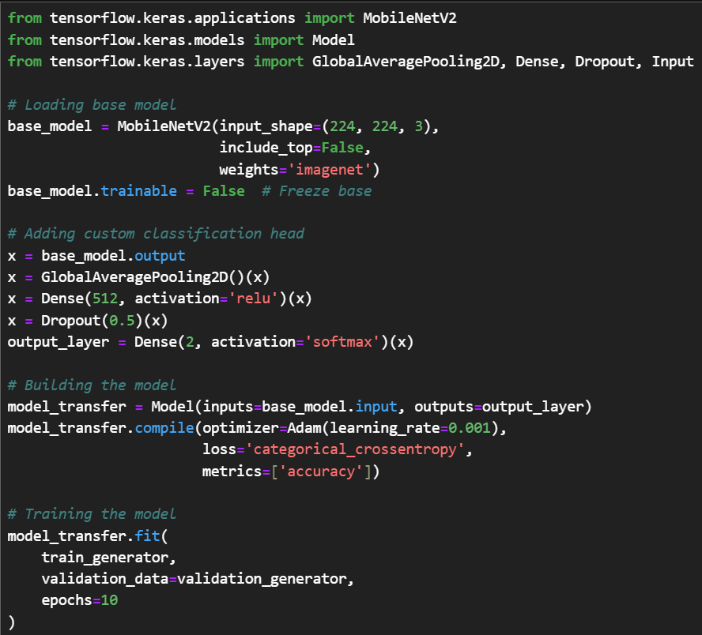

Slide 12
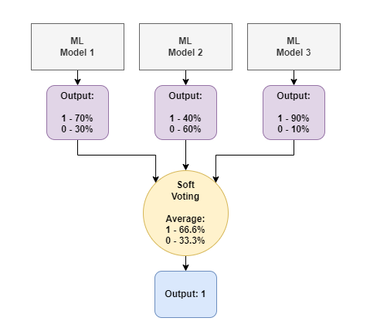
Ensemble Modelling (Soft Voting + Late Fusion)
Both CNN and MobileNetV2 models are trained independently (Parallel Ensemble)
Averages predictions from models (Soft Voting)
Combines predictions at the output layer rather than merging features early (Late Fusions)
Notes:
Average the predicted probabilities from each model for each class, and then select the class with the highest average probability as the final prediction.

Slide 13
Building the Ensemble Model (CNN + MobileNetV2)
Input shape
Ensemble input image shape: 224 × 224 × 3 (shared input)
Base Models
CNN model (frozen)
MobileNetV2 model (frozen)
→ This ensemble model takes in predictions from both the models and then averages the predictions using
soft voting.
Fusion Method
Output layer consists of the average of predictions between the two models (Soft Voting)
Model Performance
Output time: 0.00139
Validation Accuracy: 0.9419
Validation Loss: 0.1912
Notes:
When the model is frozen, their internal weights from the training are locked, they won’t learn on any new data. We are only using their finals predictions to compute an average (soft voting)

Slide 14
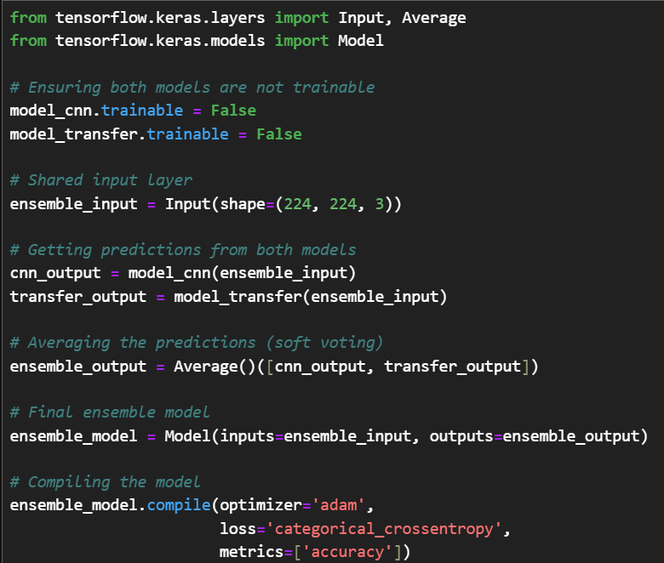

Slide 15
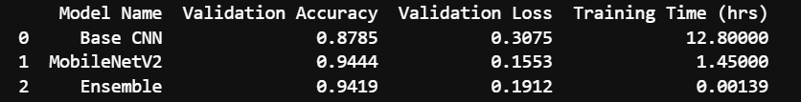
Which model to choose for Waste Classifier?
Best model
MobileNetV2
Why?
Highest Validation Accuracy: Achieved accuracy of 94.44%, outperforming CNN and the Ensemble model.
Lowest Validation Loss: Achieved a low validation loss of 0.1553, indicating better generalization and fewer prediction errors.
Efficient Training: Reached peak performance within just 10 epochs and took significantly less training time (1.45 hours), while CNN required 30 epochs and 12.8 hours
Lower Computational Cost: Lightweight architecture with fewer parameters, making it suitable for deployment on limited hardware or mobile devices.
Transfer Learning Advantage: Utilized pre-trained weights from ImageNet, allowing the model to learn more efficiently with less data

Slide 16
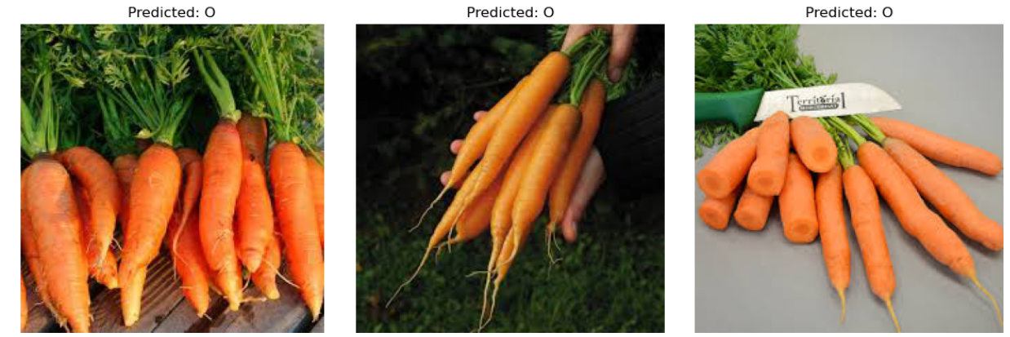
Making Predictions on the Test data

Slide 17

Building a Waste Classification UI with Gradio
Use the MobileNetV2 model to build a simple web-based, user-friendly waste classifier with Gradio
Deployment process
Saving the MobileNetV2 model permanently using model.save()
Loading the model using tensorflow.keras.models
Creating the class labels: Organic, Recyclable
Creating a prediction function (makes predictions using the model, returns class labels)
Building the Gradio User Interface (Instructions, uploading image, outputs)
Launching the app
The UI is clean and user-friendly. Can be accessed from any device.
Hugging Face Spaces was then used to host the app online.
Notes:
Hugging Face was needed because the app depended on whether my laptop was open or not. I had to host the app such that users can use it whenever they like

Slide 18
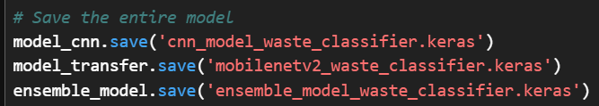
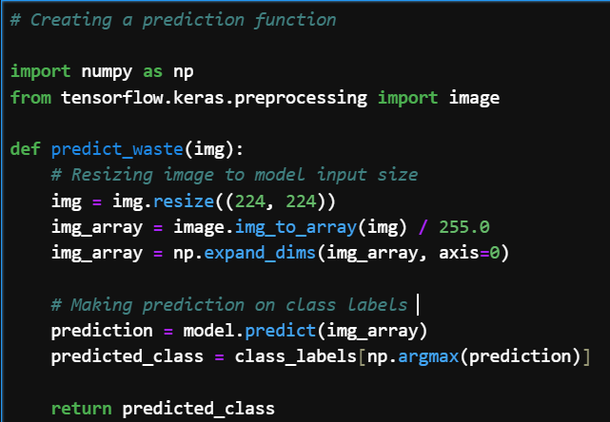
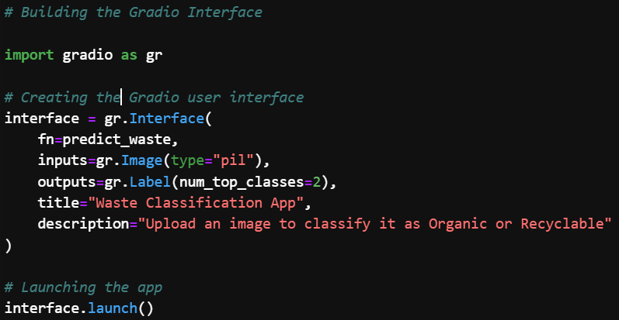
Saving the model
Creating a prediction function
Building the Gradio User Interface

Slide 19
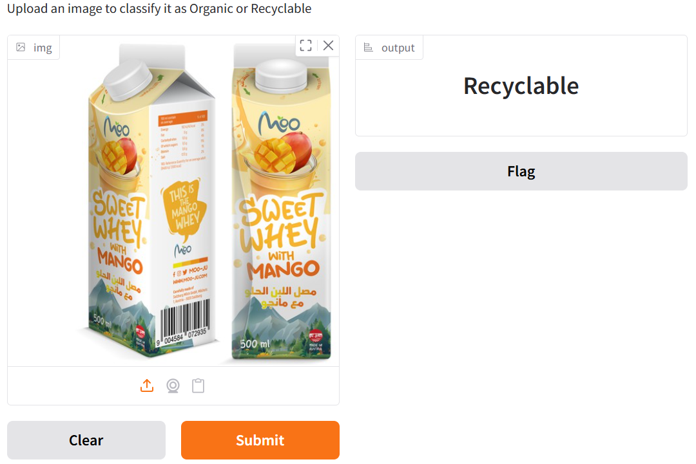
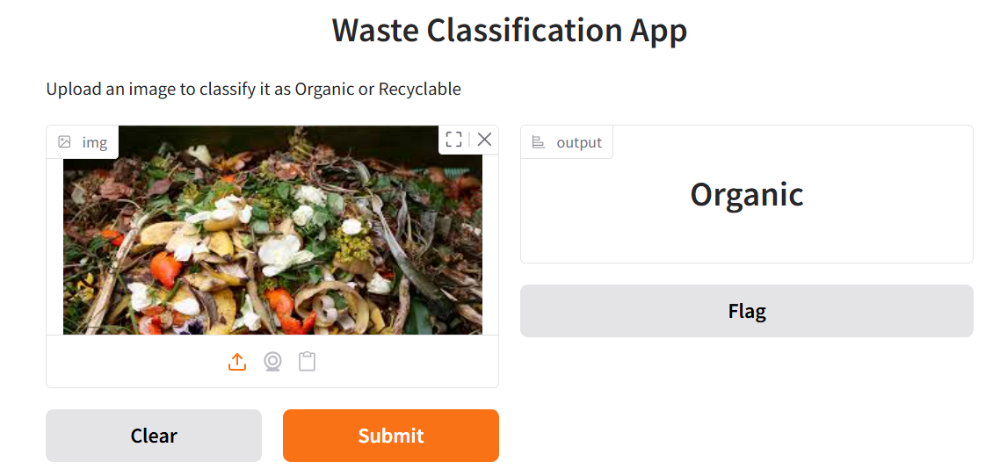
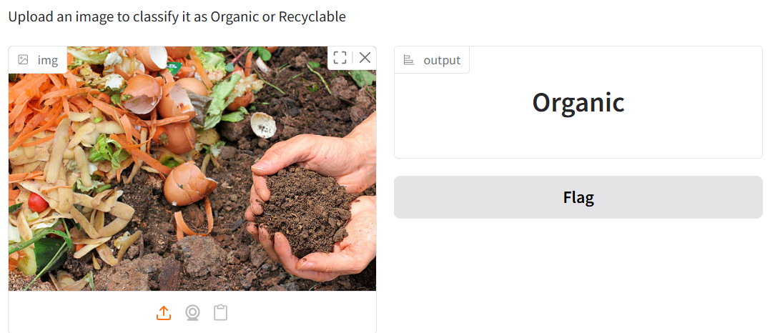
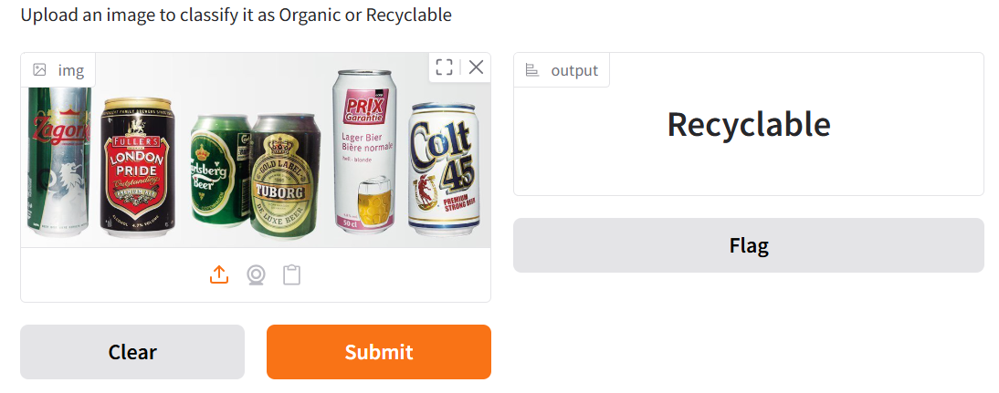

Slide 20
Limitations
Limited Classes
Currently trained only on two classes: Recyclable and Organic. Real-world waste includes many other categories such as electronics (e-waste, batteries), hazardous (pesticides, chemicals), textiles, non-recyclables (sanitary napkins, ceramics, Styrofoam products)
This model will only predict on the two classes.
Performance on non-waste Classes
If the model encounters other types of images such as human body, animals, anything else, it won’t classify it as “not-waste” or “unknown”
Environmental Sensitivity
Model might struggle with low-light, cluttered images compared to cleaner datasets

Slide 21
Business Insights
Learning New Classes
The model can be retrained on various different waste classes apart from Organic and Recyclable to effectively segregate wastes into distinct categories
Smart Waste Sorting
Can be integrated into smart bins or conveyor systems to auto-sort waste at homes, offices, public spaces, recycling plants
Efficiency in Recycling Operations
Reduces the errors associated with manual waste segregation and assists and help users get educated about the classes of wastes
Policy Support
Can assist local governments or municipalities in automating compliance checks for proper waste segregation.

Slide 22
Thank you!!

